Slide 1
ECC Final Project
Low-Density Parity-Check Codes
陳品維
E24104286

Slide 2
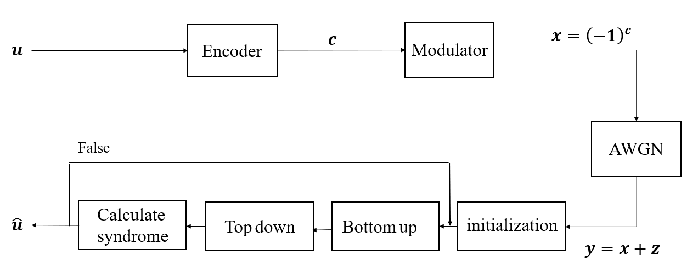
LDPC Codes Block Diagram
LDPC Codes Block Diagram

Slide 3
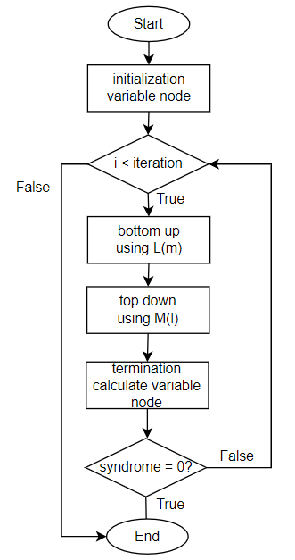
LDPC程式流程圖
Get the ymatrix，start the decoding process
Initialization
Bottom up decoding
Top down decoding
Termaination
Check the syndrome is zero(or not)
End/start the next iteration

Slide 4
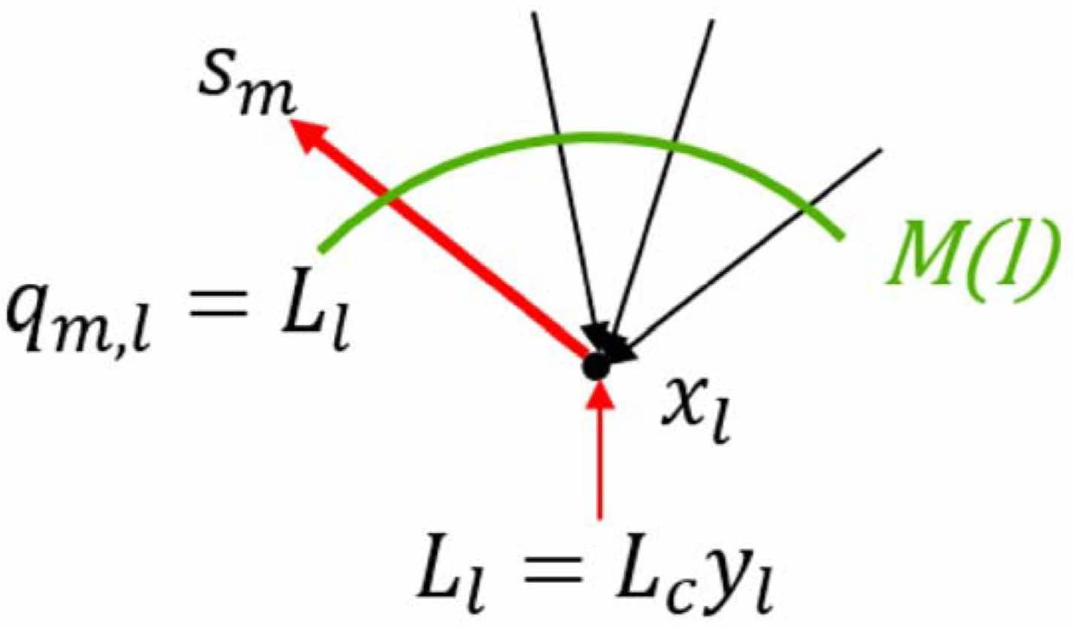
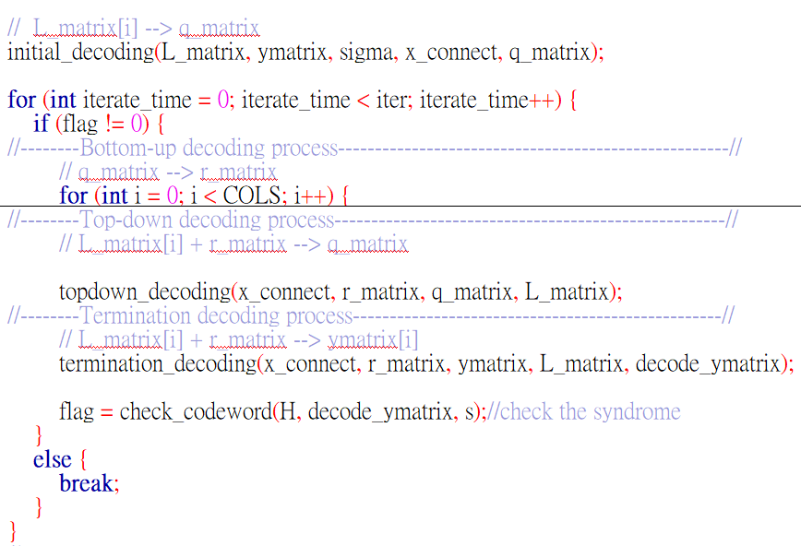
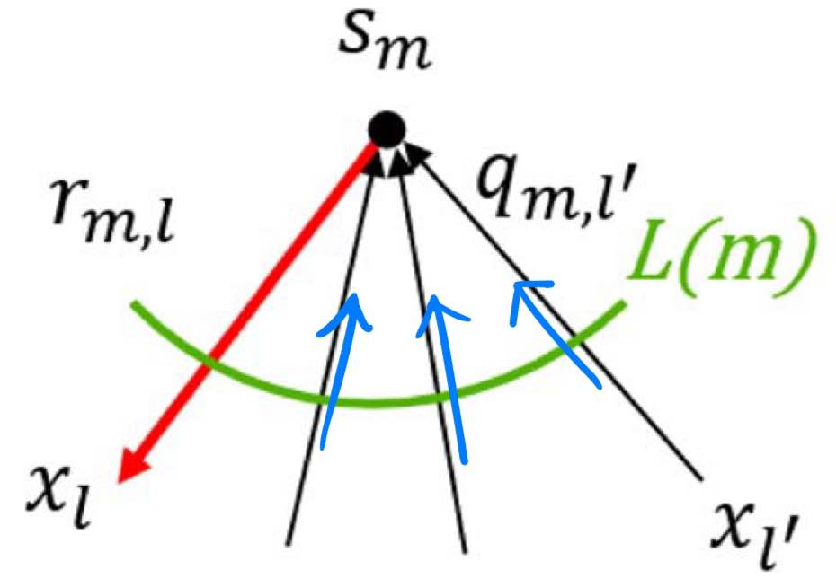
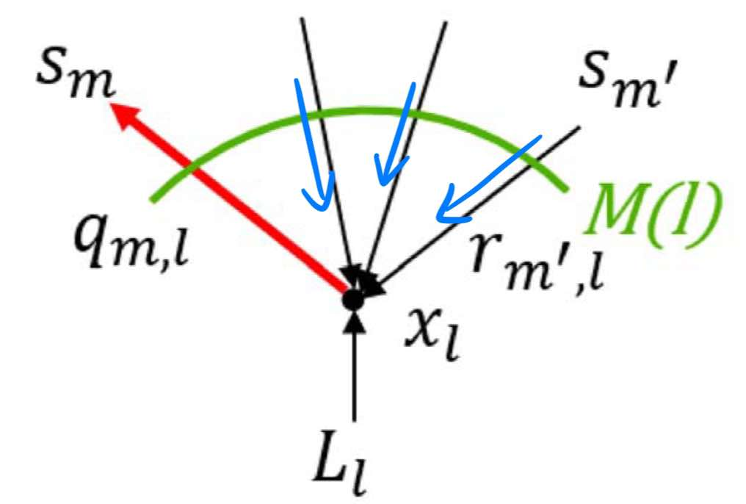
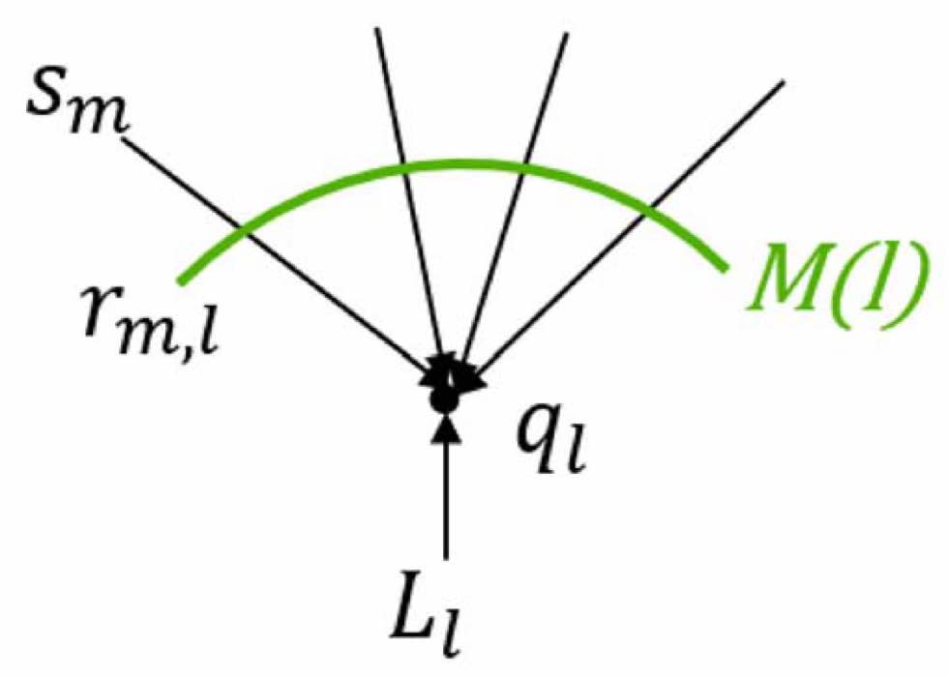
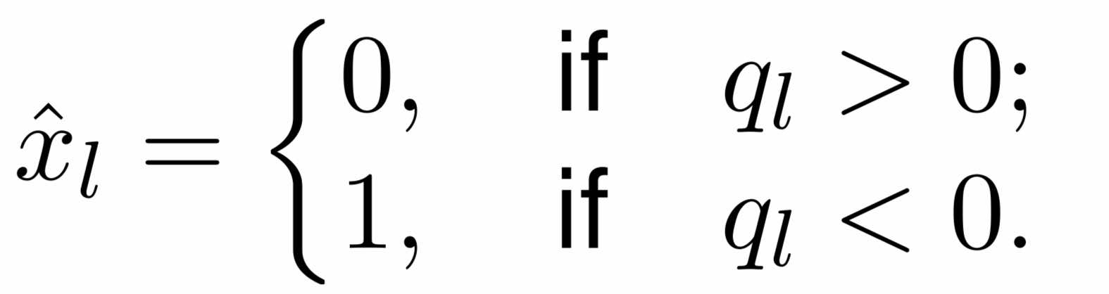
主要程式內容
initial_decoding
(define L_matrix, q_matrix)
---------------------------------------
2. Bottom-up decoding
(q_matrix → r_matrix)
3. Topdown_decoding
(L_matrix + r_matrix → q_matrix)
4. Termination_decoding
(L_matrix + r_matrix → q_matrix)
(q_matrix → ymatrix)
5. Check_codeword
(check s = H*y = 0)
Flag: decide the decoding termination

Slide 5
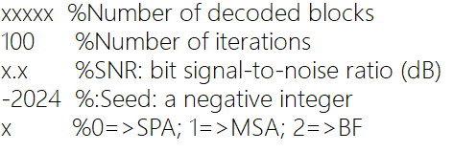
參數設定
Sim.txt
(1) Number of maximum iterations的次數為100次
(2) Seed = -2024
◎ 暫時沒有設計Bit-Flipping decoding algorithm

Slide 6
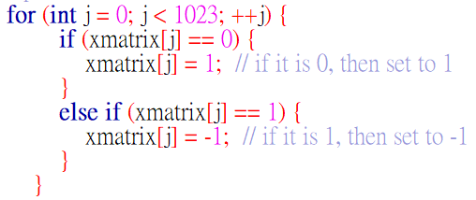
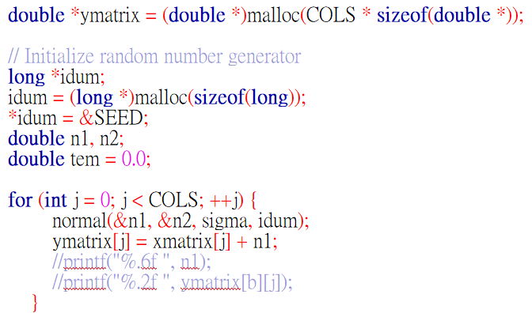
BPSK modulation & AWGN channel
BPSK modulation
AWGN channel

Slide 7
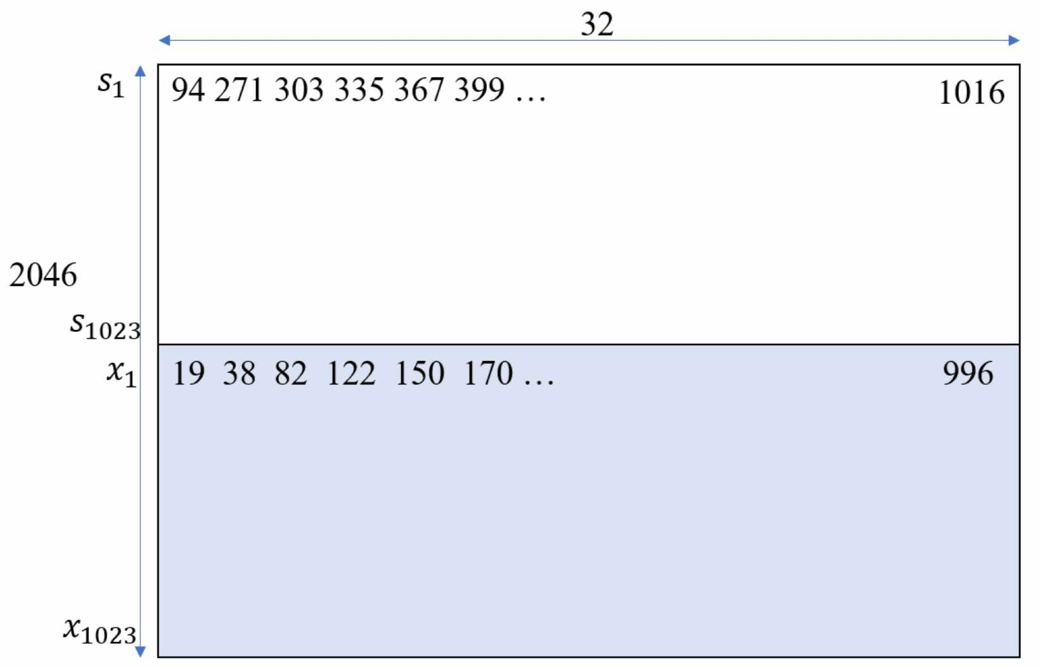
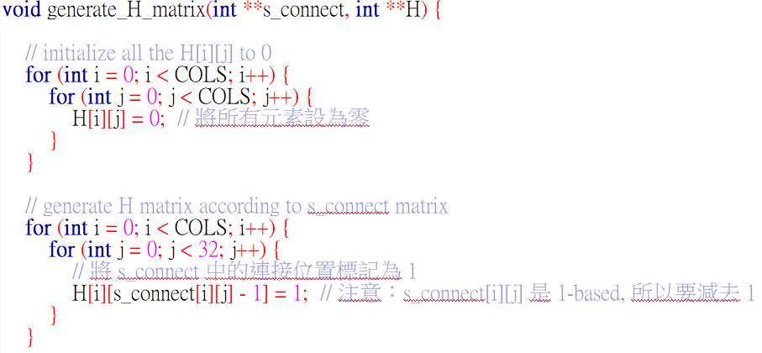
Generate parity-check matrix (H)
Source: “ ldpc_H_1023.txt ”
s_connect[1023][32] → H[1023][1023]

Slide 8
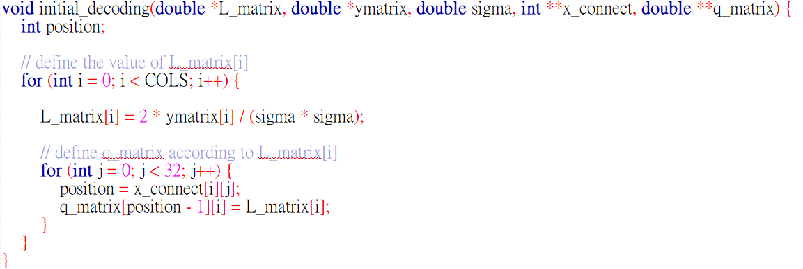

Initial decoding

Slide 9
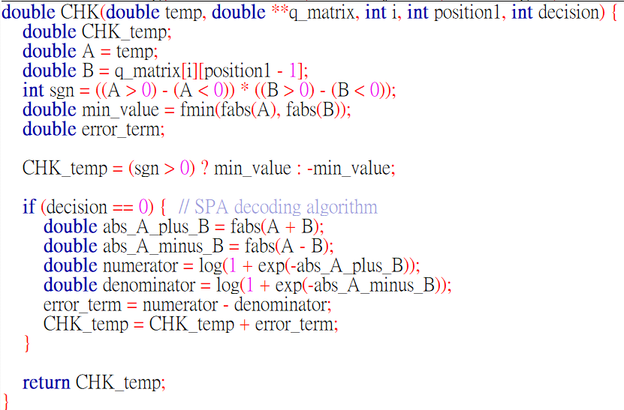

Bottom-up decoding

Slide 10
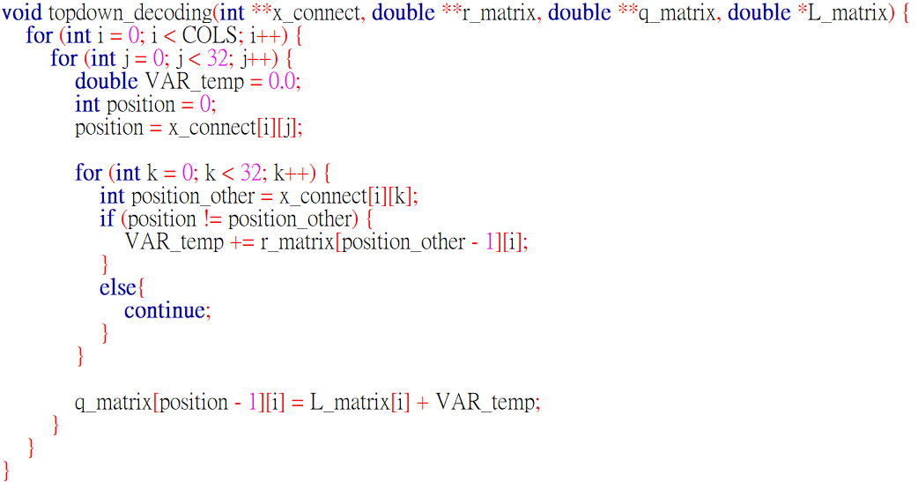
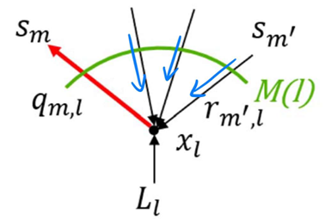
Topdown_decoding

Slide 11
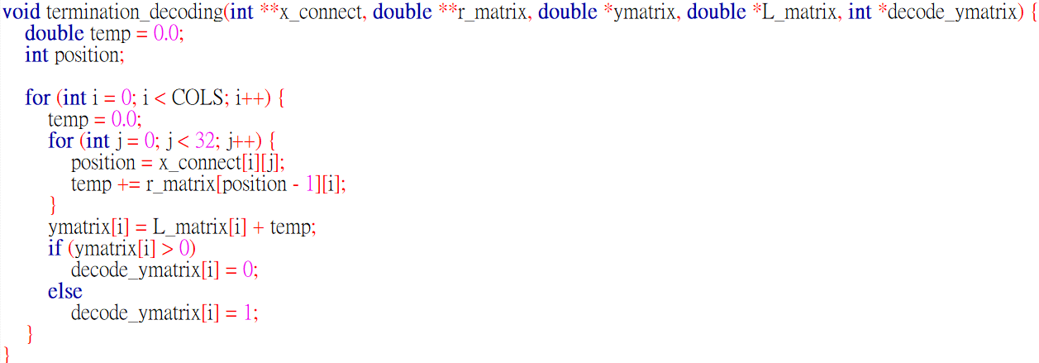

Termination_decoding

Slide 12
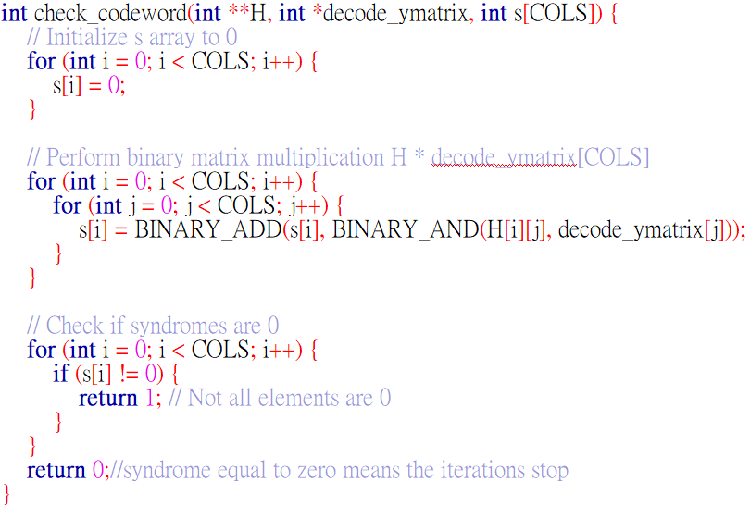
Check_codeword
計算syndrome檢查是否為正確codeword
要滿足s[1023]裡面每個元素皆為0
Return 1 → flag = 1 , 繼續進行iteration
Return 0 → flag = 0 , s[1023]全為零, end

Slide 13
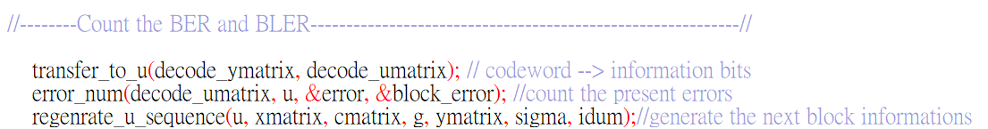
每個block decode結束就計算一次BER/BLER
＊計算結束後，為了節省記憶體，當下重新生成下一個BLOCK 的 u[781] information bits

Slide 14
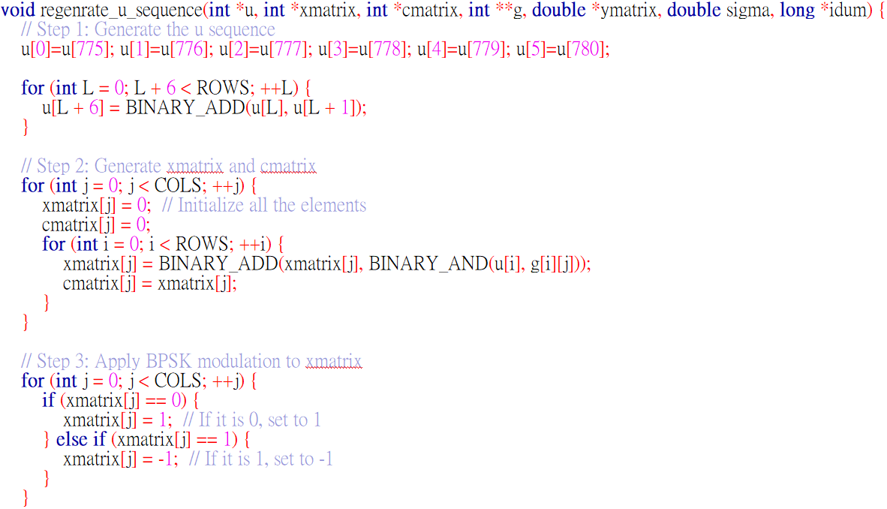
Regenerate_u_sequence
紀錄上一次u[781]中的最後6個bits
根據遞迴規則重新生成一組u[781]
X = U * G
BPSK & AWGN → ymatrix = xmatrix + n

Slide 15
SPA(Sum-Product Algorithm) 100 iteration
SNR | 1.0 | 1.2 | 1.4 | 1.6 | 1.8 | 2.0 | 2.2 | 2.4
BLOCK | 100 | 100 | 200 | 200 | 200 | 1000 | 1000 | 1000
No. bit errors | 6419 | 6033 | 11284 | 10434 | 9326 | 40146 | 30077 | 18649
No.block errors | 100 | 100 | 200 | 199 | 191 | 875 | 684 | 439
BER | 0.082190 | 0.077247 | 0.072241 | 0.066799 | 0.059706 | 0.051403 | 0.038511 | 0.023878
BLER | 1 | 1 | 1 | 0.995000 | 0.955000 | 0.875000 | 0.684000 | 0.439
SNR | 2.6 | 2.8 | 3.0 | 3.2 | 3.4 | 3.6
BLOCK | 1000 | 1000 | 10000 | 10000 | 50000 | 50000
No. bit errors | 8984 | 3809 | 8931 | 2318 | 3394 | 959
No.block errors | 217 | 96 | 212 | 57 | 82 | 23
BER | 0.011503 | 0.004877 | 0.001144 | 0.000297 | 0.000087 | 0.000025
BLER | 0.217000 | 0.096000 | 0.021200 | 0.005700 | 0.001640 | 0.000460

Slide 16
SPA(Sum-Product Algorithm) 30 iteration
SNR | 1.0 | 1.2 | 1.4 | 1.6 | 1.8 | 2.0 | 2.2 | 2.4
BLOCK | 200 | 200 | 200 | 200 | 200 | 1000 | 1000 | 1000
No. bit errors | 12857 | 12081 | 11284 | 10434 | 9330 | 40465 | 30294 | 19353
No.block errors | 200 | 200 | 200 | 199 | 191 | 884 | 695 | 462
BER | 0.082311 | 0.077343 | 0.072241 | 0.066799 | 0.059731 | 0.051812 | 0.038789 | 0.024780
BLER | 1 | 1 | 1 | 0.995000 | 0.955000 | 0.884000 | 0.695000 | 0.462000
SNR | 2.6 | 2.8 | 3.0 | 3.2 | 3.4 | 3.6
BLOCK | 1000 | 1000 | 10000 | 10000 | 50000 | 50000
No. bit errors | 10176 | 4863 | 16295 | 5933 | 10047 | 2705
No.block errors | 246 | 121 | 409 | 153 | 246 | 65
BER | 0.013029 | 0.006227 | 0.002086 | 0.000760 | 0.000257 | 0.000069
BLER | 0.246000 | 0.121000 | 0.040900 | 0.015300 | 0.004920 | 0.001300

Slide 17
MSA(Min-Sum Algorithm) 100 iteration
SNR | 1.0 | 1.2 | 1.4 | 1.6 | 1.8 | 2.0 | 2.2 | 2.4
BLOCK | 500 | 500 | 500 | 500 | 500 | 500 | 500 | 500
No. bit errors | 50544 | 49663 | 47738 | 47077 | 45484 | 44595 | 43671 | 42188
No.block errors | 500 | 500 | 500 | 500 | 500 | 500 | 500 | 498
BER | 0.129434 | 0.127178 | 0.122248 | 0.120556 | 0.116476 | 0.114200 | 0.111834 | 0.108036
BLER | 1 | 1 | 1 | 1 | 1 | 1 | 1 | 0.996000
SNR | 2.6 | 2.8 | 3.0 | 3.2 | 3.4 | 3.6 | 3.8 | 4.0
BLOCK | 500 | 500 | 500 | 500 | 500 | 500 | 1000 | 5000
No. bit errors | 41081 | 38675 | 35150 | 27444 | 19255 | 11618 | 10164 | 14387
No.block errors | 496 | 477 | 438 | 354 | 249 | 151 | 133 | 196
BER | 0.105201 | 0.099040 | 0.090013 | 0.070279 | 0.049309 | 0.029752 | 0.013014 | 0.003684
BLER | 0.992000 | 0.954000 | 0.876 | 0.708 | 0.498000 | 0.302000 | 0.133000 | 0.039200
SNR | 4.2 | 4.4 | 4.6
BLOCK | 20000 | 60000 | 100000
No. bit errors | 14057 | 6047 | 1638
No.block errors | 192 | 83 | 22
BER | 0.000900 | 0.000129 | 0.000021
BLER | 0.009600 | 0.001383 | 0.000220

Slide 18
MSA(Min-Sum Algorithm) 50 iteration
SNR | 1.0 | 1.2 | 1.4 | 1.6 | 1.8 | 2.0 | 2.2 | 2.4
BLOCK | 200 | 200 | 200 | 200 | 200 | 200 | 200 | 200
No. bit errors | 20277 | 19633 | 19033 | 18965 | 18331 | 17582 | 17177 | 16681
No.block errors | 200 | 200 | 200 | 200 | 200 | 200 | 200 | 199
BER | 0.129814 | 0.125691 | 0.121850 | 0.121415 | 0.117356 | 0.112561 | 0.109968 | 0.106793
BLER | 1 | 1 | 1 | 1 | 1 | 1 | 1 | 0.995000
SNR | 2.6 | 2.8 | 3.0 | 3.2 | 3.4 | 3.6 | 3.8 | 4.0
BLOCK | 500 | 500 | 500 | 500 | 500 | 500 | 1000 | 5000
No. bit errors | 41628 | 39113 | 34906 | 27472 | 19076 | 11323 | 9725 | 14731
No.block errors | 496 | 477 | 438 | 354 | 249 | 151 | 133 | 196
BER | 0.106602 | 0.100161 | 0.089388 | 0.070351 | 0.048850 | 0.028996 | 0.012452 | 0.003772
BLER | 0.992000 | 0.954000 | 0.876000 | 0.708000 | 0.498000 | 0.302000 | 0.133000 | 0.039200
SNR | 4.2 | 4.4 | 4.6
BLOCK | 20000 | 60000 | 100000
No. bit errors | 14235 | 6098 | 1612
No.block errors | 192 | 83 | 22
BER | 0.000911 | 0.000130 | 0.000021
BLER | 0.009600 | 0.001383 | 0.000220

Slide 19
MSA(Min-Sum Algorithm) 30 iteration
SNR | 1.0 | 1.2 | 1.4 | 1.6 | 1.8 | 2.0 | 2.2 | 2.4
BLOCK | 200 | 200 | 200 | 200 | 200 | 200 | 200 | 200
No. bit errors | 20585 | 19714 | 18510 | 18438 | 18366 | 17626 | 17134 | 16770
No.block errors | 200 | 200 | 200 | 200 | 200 | 200 | 200 | 199
BER | 0.131786 | 0.126210 | 0.118502 | 0.118041 | 0.117580 | 0.112843 | 0.109693 | 0.107362
BLER | 1 | 1 | 1 | 1 | 1 | 1 | 1 | 0.995000
SNR | 2.6 | 2.8 | 3.0 | 3.2 | 3.4 | 3.6 | 3.8 | 4.0
BLOCK | 500 | 500 | 500 | 500 | 500 | 500 | 1000 | 5000
No. bit errors | 40892 | 38691 | 34328 | 27581 | 19157 | 11752 | 9807 | 14453
No.block errors | 496 | 477 | 438 | 354 | 249 | 151 | 133 | 196
BER | 0.104717 | 0.099081 | 0.087908 | 0.070630 | 0.049058 | 0.030095 | 0.012557 | 0.003701
BLER | 0.992000 | 0.954000 | 0.876000 | 0.708000 | 0.498000 | 0.302000 | 0.133000 | 0.039200
SNR | 4.2 | 4.4 | 4.6
BLOCK | 20000 | 60000 | 100000
No. bit errors | 14513 | 6499 | 1561
No.block errors | 192 | 83 | 22
BER | 0.000929 | 0.000139 | 0.000020
BLER | 0.009600 | 0.001383 | 0.000220

Slide 20
BF(Bit-Flipping Algorithm) 100 iteration
SNR | 1.0 | 1.2 | 1.4 | 1.6 | 1.8 | 2.0 | 2.2 | 2.4
BLOCK | 500 | 500 | 500 | 500 | 500 | 500 | 500 | 500
No. bit errors | 53158 | 51242 | 50087 | 48322 | 47578 | 47632 | 43492 | 42211
No.block errors | 500 | 500 | 500 | 500 | 500 | 500 | 500 | 500
BER | 0.136128 | 0.131222 | 0.128264 | 0.123744 | 0.121839 | 0.121977 | 0.111375 | 0.108095
BLER | 1 | 1 | 1 | 1 | 1 | 1 | 1 | 1
SNR | 2.6 | 2.8 | 3.0 | 3.2 | 3.4 | 3.6 | 3.8 | 4.0
BLOCK | 500 | 500 | 500 | 500 | 500 | 500 | 500 | 1000
No. bit errors | 38495 | 33937 | 35513 | 27638 | 21384 | 15864 | 11506 | 11276
No.block errors | 500 | 494 | 481 | 424 | 360 | 269 | 177 | 200
BER | 0.098579 | 0.086907 | 0.090942 | 0.070776 | 0.054761 | 0.040625 | 0.029465 | 0.014438
BLER | 1 | 0.988000 | 0.962000 | 0.848000 | 0.720000 | 0.538000 | 0.354000 | 0.200000
SNR | 4.2 | 4.4 | 4.6 | 4.8 | 5.0
BLOCK | 2000 | 10000 | 20000 | 50000 | 50000
No. bit errors | 9173 | 13095 | 7710 | 2598 | 477
No.block errors | 154 | 238 | 137 | 64 | 11
BER | 0.005873 | 0.001677 | 0.000494 | 0.000067 | 0.000012
BLER | 0.077000 | 0.023800 | 0.006850 | 0.001280 | 0.000220

Slide 21
BF(Bit-Flipping Algorithm) 50 iteration
SNR | 1.0 | 1.2 | 1.4 | 1.6 | 1.8 | 2.0 | 2.2 | 2.4
BLOCK | 500 | 500 | 500 | 500 | 500 | 500 | 500 | 500
No. bit errors | 52473 | 50611 | 48854 | 48174 | 47352 | 47554 | 42246 | 42048
No.block errors | 500 | 500 | 500 | 500 | 500 | 500 | 500 | 500
BER | 0.134374 | 0.129606 | 0.125106 | 0.123365 | 0.121260 | 0.121777 | 0.108184 | 0.107677
BLER | 1 | 1 | 1 | 1 | 1 | 1 | 1 | 1
SNR | 2.6 | 2.8 | 3.0 | 3.2 | 3.4 | 3.6 | 3.8 | 4.0
BLOCK | 500 | 500 | 500 | 500 | 500 | 500 | 500 | 1000
No. bit errors | 38314 | 32786 | 35402 | 27519 | 21197 | 15830 | 10377 | 11276
No.block errors | 500 | 494 | 481 | 424 | 360 | 269 | 177 | 200
BER | 0.098115 | 0.083959 | 0.090658 | 0.070471 | 0.054282 | 0.040538 | 0.026574 | 0.014438
BLER | 1 | 0.988000 | 0.962000 | 0.848000 | 0.720000 | 0.538000 | 0.354000 | 0.200000
SNR | 4.2 | 4.4 | 4.6 | 4.8 | 5.0
BLOCK | 2000 | 10000 | 20000 | 50000 | 50000
No. bit errors | 9154 | 12429 | 7674 | 2597 | 475
No.block errors | 154 | 238 | 137 | 64 | 11
BER | 0.005860 | 0.001591 | 0.000491 | 0.000067 | 0.000012
BLER | 0.077000 | 0.023800 | 0.006850 | 0.001280 | 0.000220

Slide 22
BF(Bit-Flipping Algorithm) 30 iteration
SNR | 1.0 | 1.2 | 1.4 | 1.6 | 1.8 | 2.0 | 2.2 | 2.4
BLOCK | 500 | 500 | 500 | 500 | 500 | 500 | 500 | 500
No. bit errors | 49815 | 45033 | 43801 | 44039 | 43028 | 41100 | 38980 | 37807
No.block errors | 500 | 500 | 500 | 500 | 500 | 500 | 500 | 500
BER | 0.127567 | 0.115321 | 0.112166 | 0.112776 | 0.110187 | 0.105250 | 0.099821 | 0.096817
BLER | 1 | 1 | 1 | 1 | 1 | 1 | 1 | 1
SNR | 2.6 | 2.8 | 3.0 | 3.2 | 3.4 | 3.6 | 3.8 | 4.0
BLOCK | 500 | 500 | 500 | 500 | 500 | 500 | 500 | 1000
No. bit errors | 33475 | 31577 | 30758 | 25582 | 18925 | 14758 | 9393 | 9892
No.block errors | 500 | 494 | 481 | 424 | 360 | 269 | 177 | 200
BER | 0.085723 | 0.080863 | 0.078766 | 0.065511 | 0.048464 | 0.037793 | 0.024054 | 0.012666
BLER | 1 | 0.988000 | 0.962000 | 0.848000 | 0.720000 | 0.538000 | 0.354000 | 0.200000
SNR | 4.2 | 4.4 | 4.6 | 4.8 | 5.0
BLOCK | 2000 | 10000 | 20000 | 50000 | 50000
No. bit errors | 8355 | 12250 | 6904 | 2527 | 1507
No.block errors | 154 | 238 | 137 | 64 | 22
BER | 0.005349 | 0.001569 | 0.000442 | 0.000065 | 0.0000190
BLER | 0.077000 | 0.023800 | 0.006850 | 0.001280 | 0.000220

Slide 23
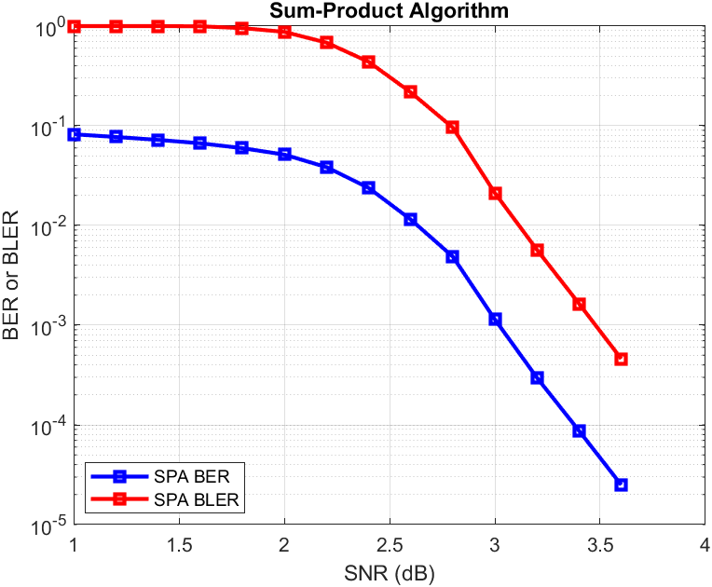
SPA simulation(100 iteration)

Slide 24
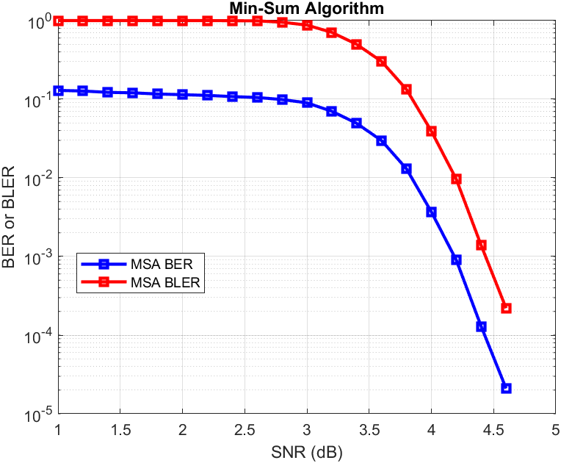
MSA simulation(100 iteration)

Slide 25
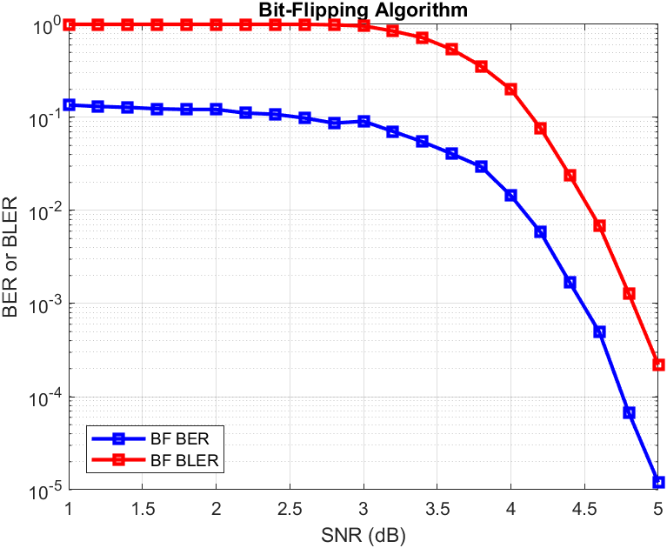
BF simulation(100 iteration)

Slide 26
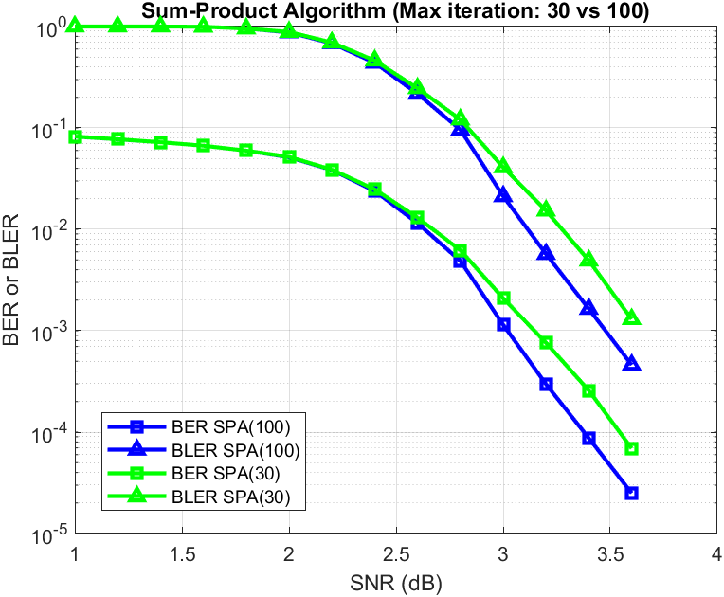
SPA simulation(100 / 30 iteration)

Slide 27
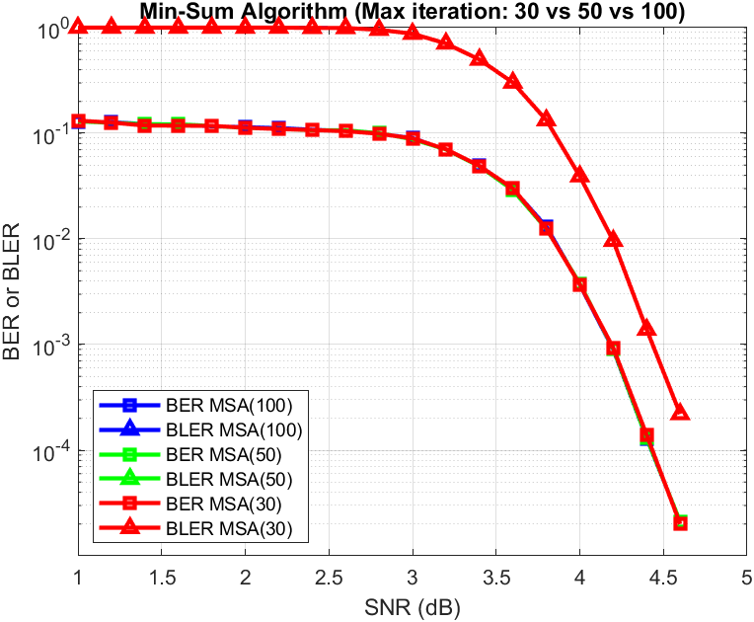
MSA simulation(100 / 50 / 30 iteration)

Slide 28
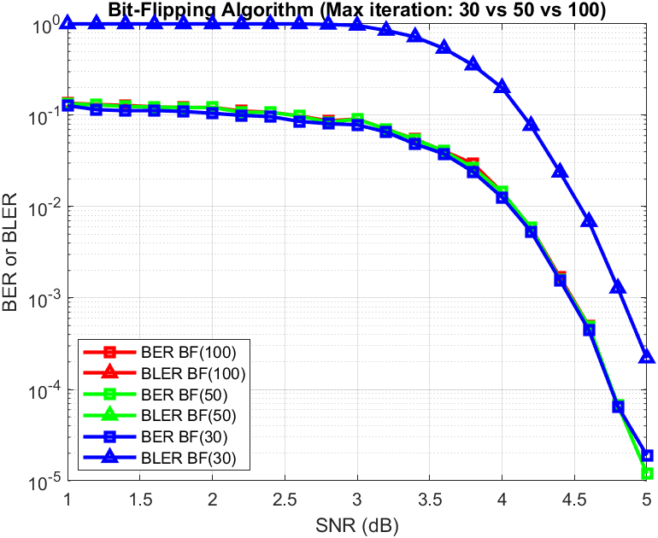
BF simulation(100 / 50 / 30 iteration)

Slide 29
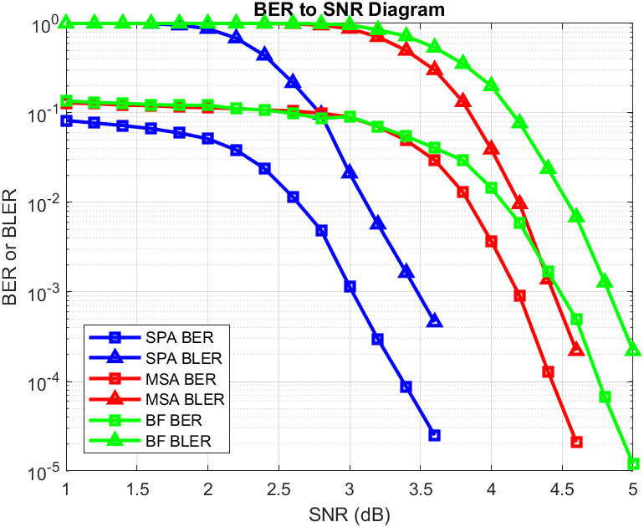
Overall Comparison (Max iteration: 100)

Slide 30
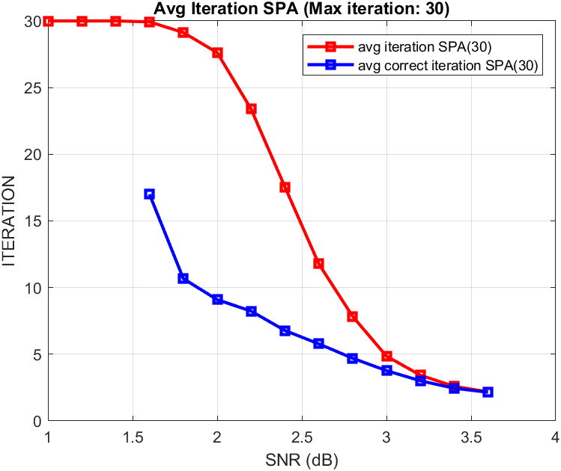
SPA simulation(30 iteration)
在SNR = 1.6以前都尚未解對
藍色線為解對情況下所需要的平均iteration次數

Slide 31
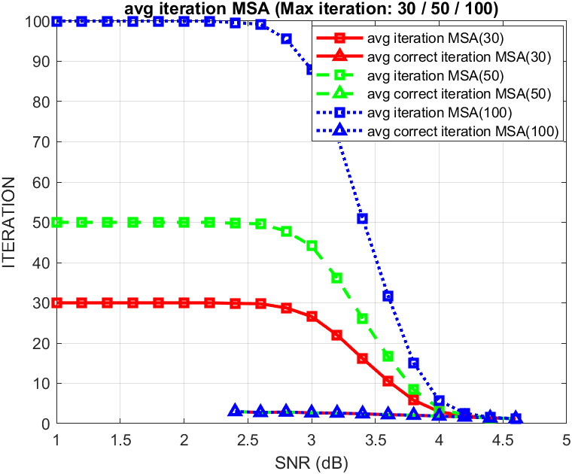
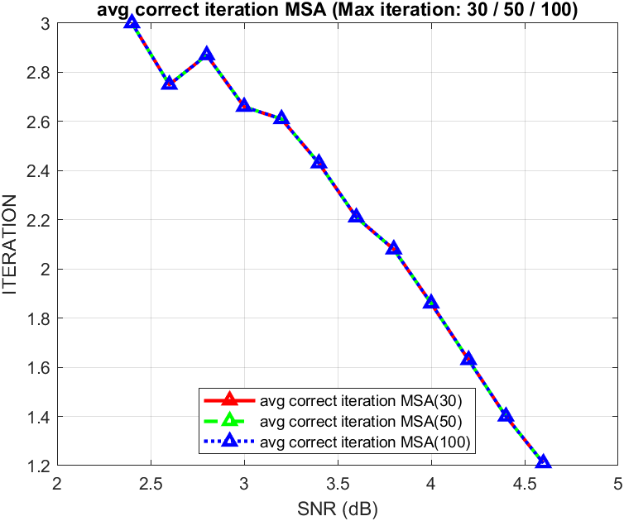
MSA simulation(100 iteration)

Slide 32
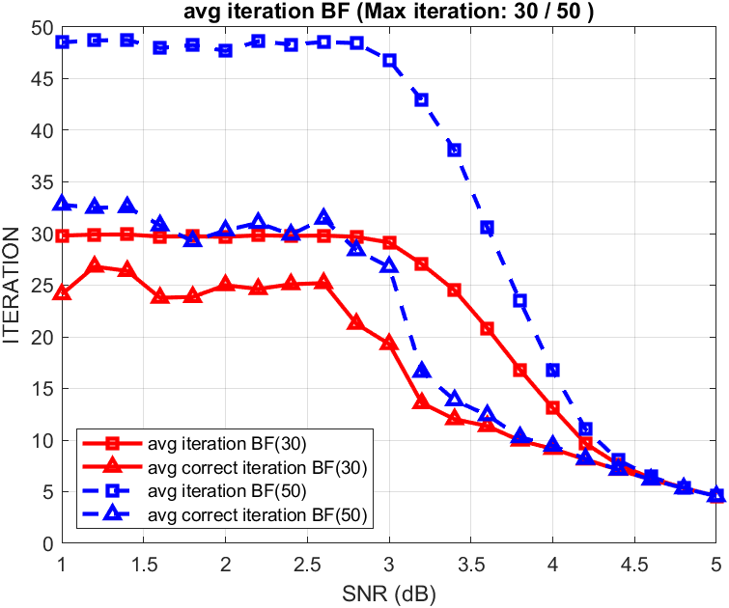
BF simulation(30 vs 50 iteration)

